Slide 1

Autonomous Predictive Tracking and Laser Neutralization System for Flies
Code: 26-1-R-22
By:
Daniel Lachmakov | Daniel.lachmakov@e.braude.ac.il
Yaniv Bodaga | Yaniv.bodaga@e.braude.ac.il
Advsors:
Dr. Dan Lemberg | Lembergdan@braude.ac.il
Mrs. Elena Kremer | Elenak@braude.ac.il

Slide 2
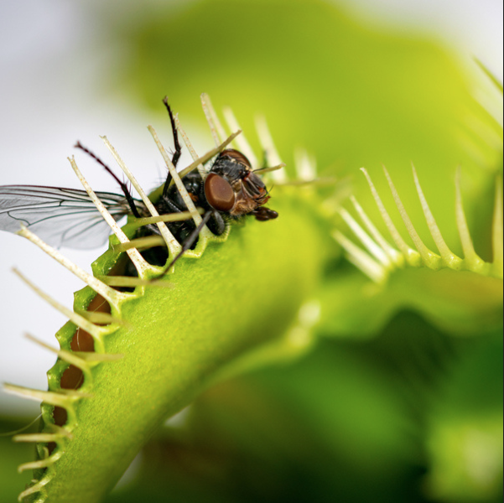
The Problem & The Need
The Issue: Flies cause contamination and disease transmission in homes, hospitals, and food industries.
The Challenge: Flies exhibit chaotic, rapid, and non-linear flight.
Current Solutions:
Chemical sprays (Health risks, environmental damage).
Manual swatting (Inefficient).
Existing automated systems (Too slow/Reactive).
The Need: An autonomous solution that operates continuously and safely without human intervention.

Slide 3
Why Existing Tech Fails (The Gap)
The "Reactive" Limit: Traditional systems aim at the current position.
System Latency: Camera processing + Motor movement = Delay.
Result: By the time the laser fires, the fly has moved.
Our Conclusion: You cannot hit a fly by looking at where it is. You must know where it will be .

Slide 4
Engineering & Research Challenges
Visual Perception Challenges:
Small Object Detection: Flies occupy very few pixels and suffer from significant motion blur due to high speed .
Cluttered Backgrounds: Dynamic lighting and textured surfaces make extraction difficult .
The "Chaos" Factor (Modeling):
Non-Linear Motion: Flies do not follow smooth paths; they exhibit rapid acceleration and abrupt turns that break standard Kalman filters.
System Constraints:
End-to-End Latency: The physical delay between sensing and actuation often exceeds the fly's reaction time.
Real-Time Computation: Running heavy Transformer models on high-frame-rate video (815 FPS) requires optimization.

Slide 5
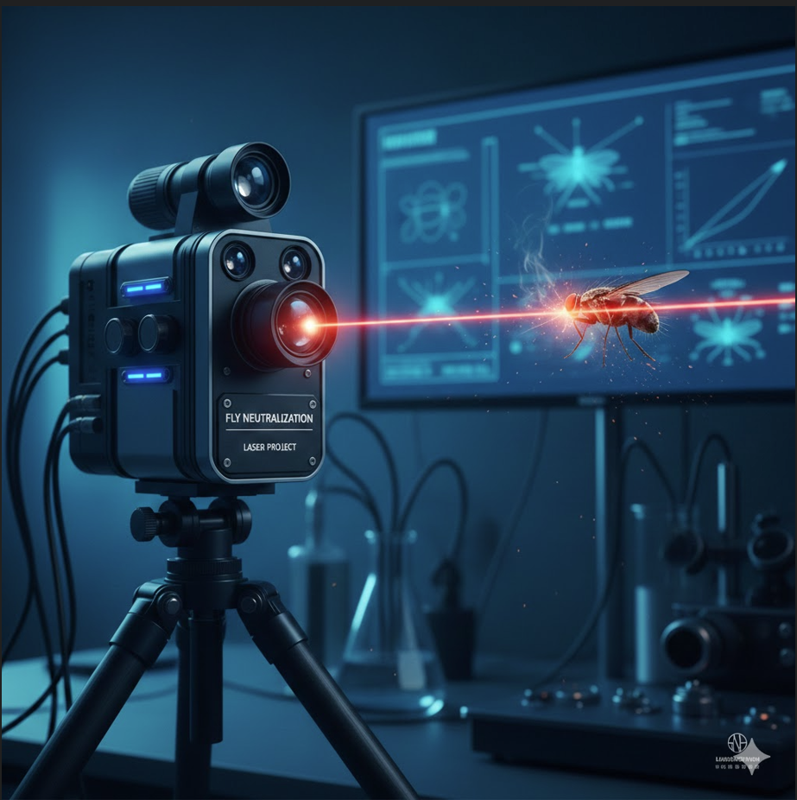

Proposed Solution & Innovation
The Goal: Build a system that compensates for latency using Future Trajectory Prediction.
The Solution:
Vision: Detect flies in real-time.
Brain: A Transformer-based AI model to predict the trajectory.
Action: Aim the laser at the future coordinate .
Key Innovation: Applying Transformer architecture to flies flight paths, allowing us to model irregular, non-linear movement.

Slide 6
Process Flow
Disable Operation
(Safety Stop)
Yes
No
Receive Video Input
AI-Based Human Detection
Human Detected?
AI-Based Fly Detection
Fly Detected?
Track Fly Across Frames
No
Yes
Attempt Fly Neutralization
Align Laser to
Predicted Position
Predict Future Fly Positions
(Transformer Model)
Build Motion Trajectory

Slide 7
Computer Vision (Detection)
Camera: Area-scan, 815 FPS(75mm lens).
Human Detection (Safety):
Uses a pre-trained robust CNN-based detection.
Challenge: Occlusion(partly hidden), variable poses, varying appearance.
Fly Detection:
Method: CNN-based detection fine-tuned on a fly dataset.
Challenge: Motion blur and small pixel area.

Slide 8
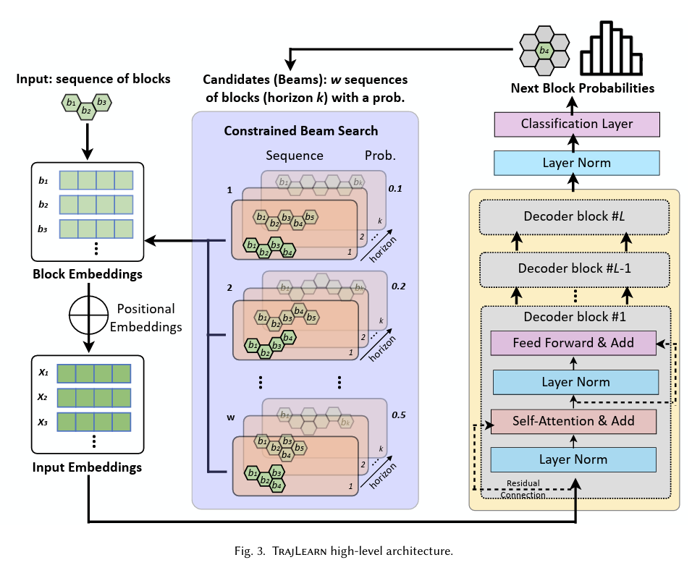
System Architecture(TrajLearn)

Slide 9
Transfer Learning from TrajLearn
Handles sequences of any object motion, including small fast-moving targets.
Pre-trained on large trajectory datasets, enabling efficient transfer learning.
Produces smooth, reliable predictions for highly erratic motion like flies.
Can be optimized for real-time inference in high-speed applications.

Slide 10

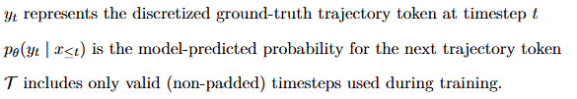
Loss Function- Cross entropy

Slide 11
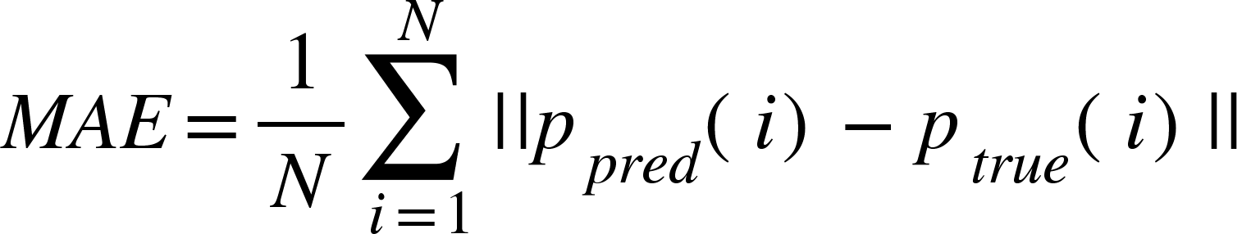
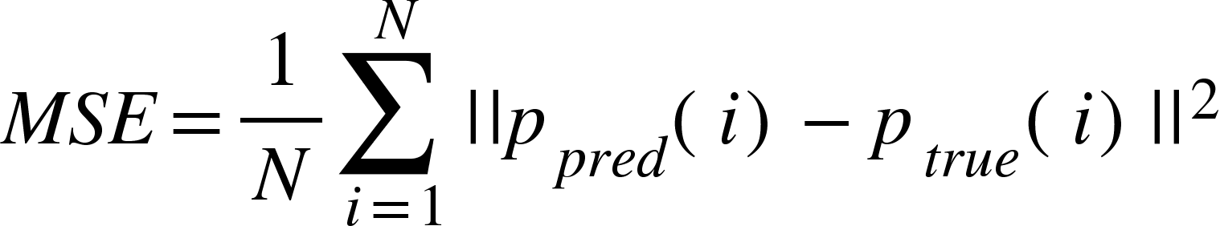
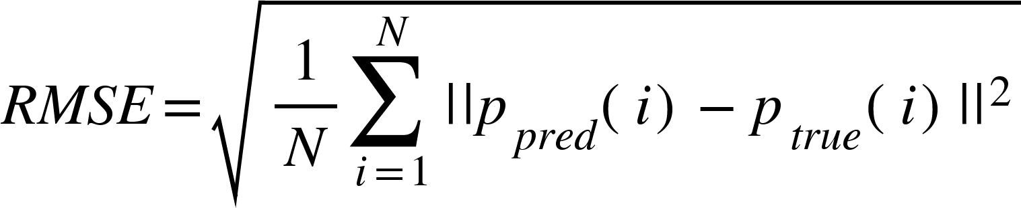
Success Metrics
We evaluate the model's prediction accuracy using standard error metrics:
Mean Absolute Error (MAE): Measures the average magnitude of errors.
Mean Squared Error (MSE): Penalizes larger errors more severely.
Root Mean Squared Error (RMSE): Provides error in the original unit.

